Slide 1
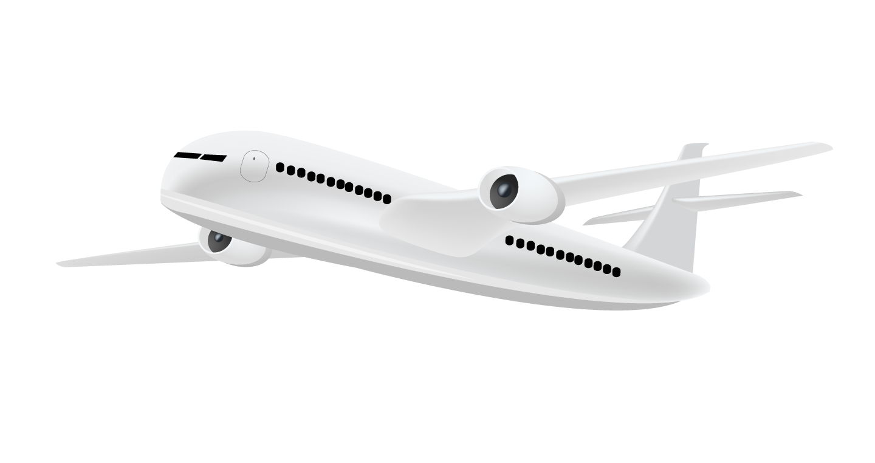
Flight Price Prediction
Presented By: Tarun Reddy

Slide 2

Table of contents
01
02
03
04
05
Problem Statement
Dataset and Features
EDA
Model Building
Future Work

Slide 3
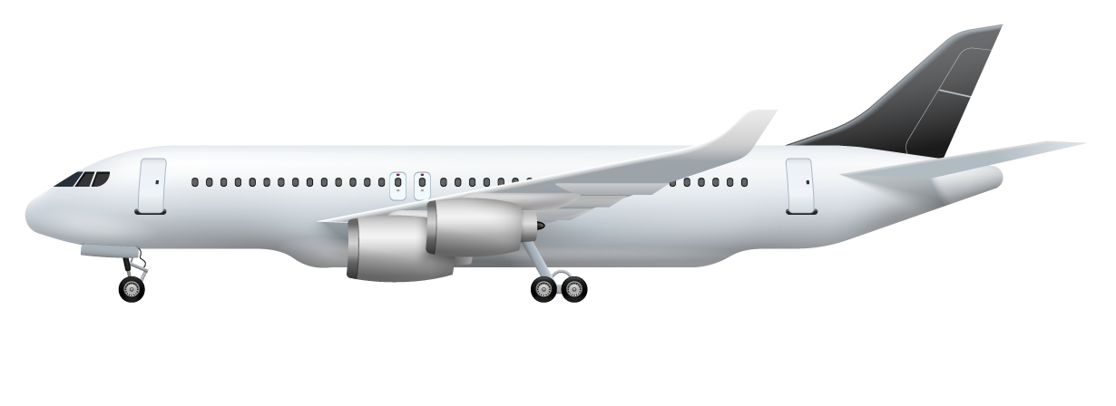
01
Problem Statement

Slide 4

Flight prices can vary widely, making it hard for travelers to budget for trips.
The project aims to develop a machine learning model to predict flight prices.
The model will use factors like departure/arrival cities, travel dates, and airlines to predict prices.
The goal is to build a model that accurately predicts flight prices to help travelers save time and money.

Slide 5
Hyper Parameter tuning
The Performance of the Model is improved by again refining the data and building the Model
Dataset
Data is collected from kaggle and stored in a dataframes.
Flow of Control of Project
Model Building
The datasets are trained and Model is Created
Exploratory Data Analysis and Feature Selection
The dataset is being investigated to discover hidden Patterns. Important features are selected.

Slide 6
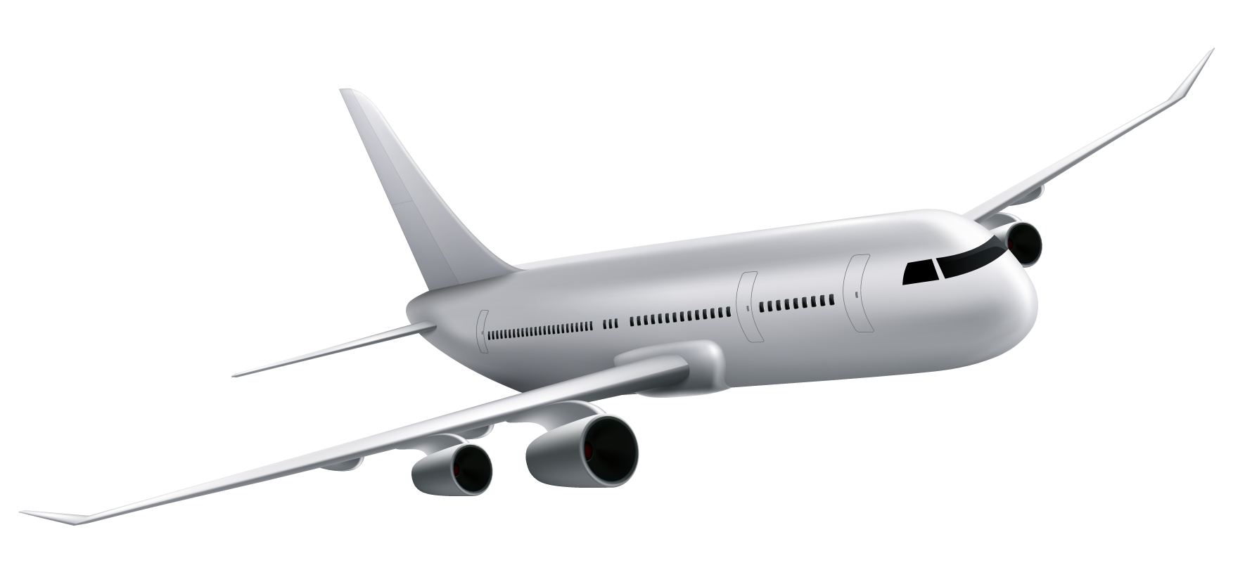
02
Dataset and Features

Slide 7
About Dataset
Link to Dataset : https://www.kaggle.com/datasets/nikhilmittal/flight-fare-prediction-mh
We have 2 datasets here — training set and test set.
The training set contains the features, along with the prices of the flights. It contains 10683 records, 10 input features and 1 output column — ‘Price’.
The test set contains 2671 records and 10 input features. The output ‘Price’ column needs to be predicted in this set.
We will use Regression techniques here, since the predicted output will be a continuous value.

Slide 8
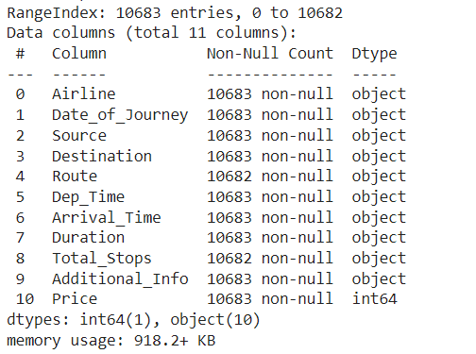
Features
Airline: The name of the airline.
Date_of_Journey: The date of the journey
Source: The source from which the service begins.
Destination: The destination where the service ends.
Route: The route taken by the flight to reach the destination.
Dep_Time: The time when the journey starts from the source.
Arrival_Time: Time of arrival at the destination.
Duration: Total duration of the flight.
Total_Stops: Total stops between the source and destination.
Additional_Info: Additional information about the flight
Price: The price of the ticket

Slide 9

03
Exploratory Data Analysis

Slide 10
Steps performed for Data Preprocessing
Missing Value Treatment
1
Filtered the row with missing value and filled it up with appropriate values as determined
2
Removed Duplicates
Selected and removed duplicate , kept the first occurrence of each row

Slide 11
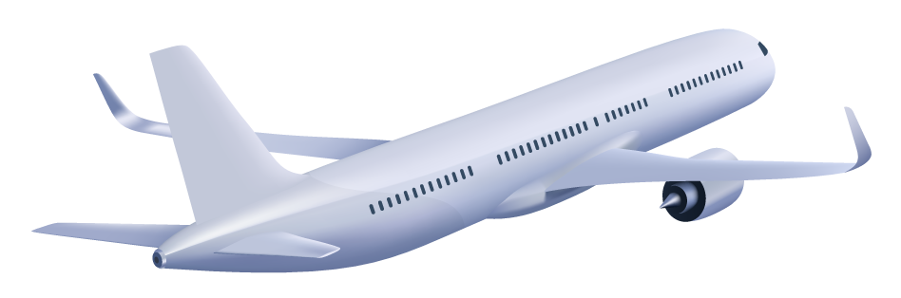
Steps for Data Preprocessing
Feature Engineering
3
Feature engineering was done on some features as they had some irrelevant values.
Converted Date_of_Journey column into integer date, month, year
Extracted Departure_Hour, Deparutre_Min and Arrival_Hour, Arrival_Min columns from Departure_time and Time_of_arrival columns .
Extracted Duration Hour and Duration Minutes from duration column.
Dropped original columns after extraction.
Handling Categorical Data:
Label Encoding
4
Label Encoding was used to treat ordinal columns as Total Stops.
Notes:
Feature engineering refers to manipulation — addition, deletion, combination, mutation — of your data set to improve machine learning model training, leading to better performance and greater accuracy.

Slide 12
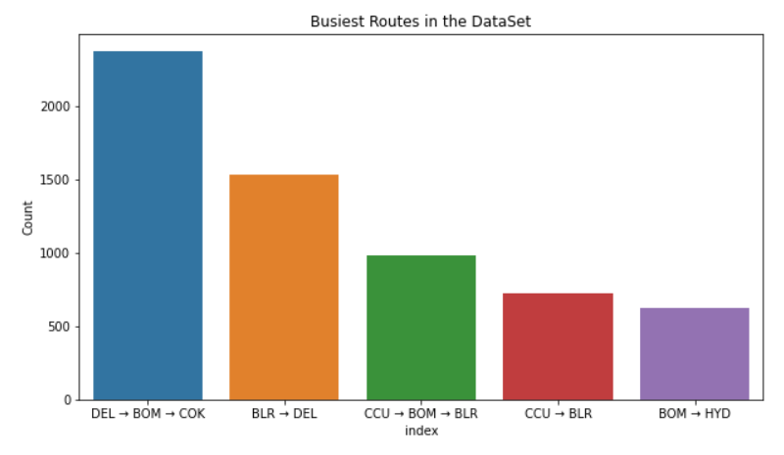
Visualization of Categorical Variables
Route
Key Finding:
1. Delhi to Cochin via Mumbai is the Busiest route with 2376 flights, Followed by Bangalore to Delhi.
Since the ‘Total_Stops’ variable captures the information if the flight is direct or connected so I decided to drop this variable.

Slide 13
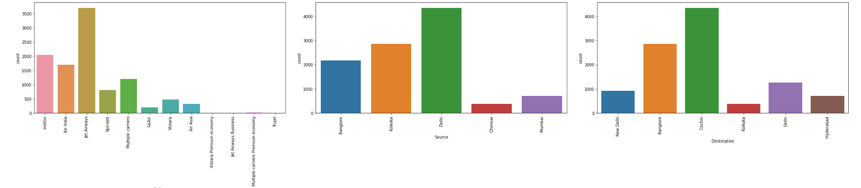
Visualization of Categorical Variables
Key Findings:
Airlines
Jet Airways was the most preferred airline followed by Indigo and AirIndia.
Source
Majority of the flights take off from Delhi
Chennai has the minimum number of flight take-offs
Destination
Maximum flights land in Cochin
Kolkata has the lowest count of receiving the flights

Slide 14
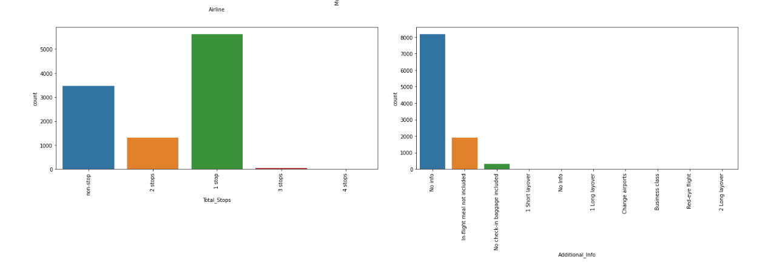
Visualization of Categorical Variables
Key Findings:
4. Additional Info
Maximum rows have No info as the value.
5. Total stops
Majority of the flights have stops as 1, flights with 3 and 4 stops are quite low

Slide 15
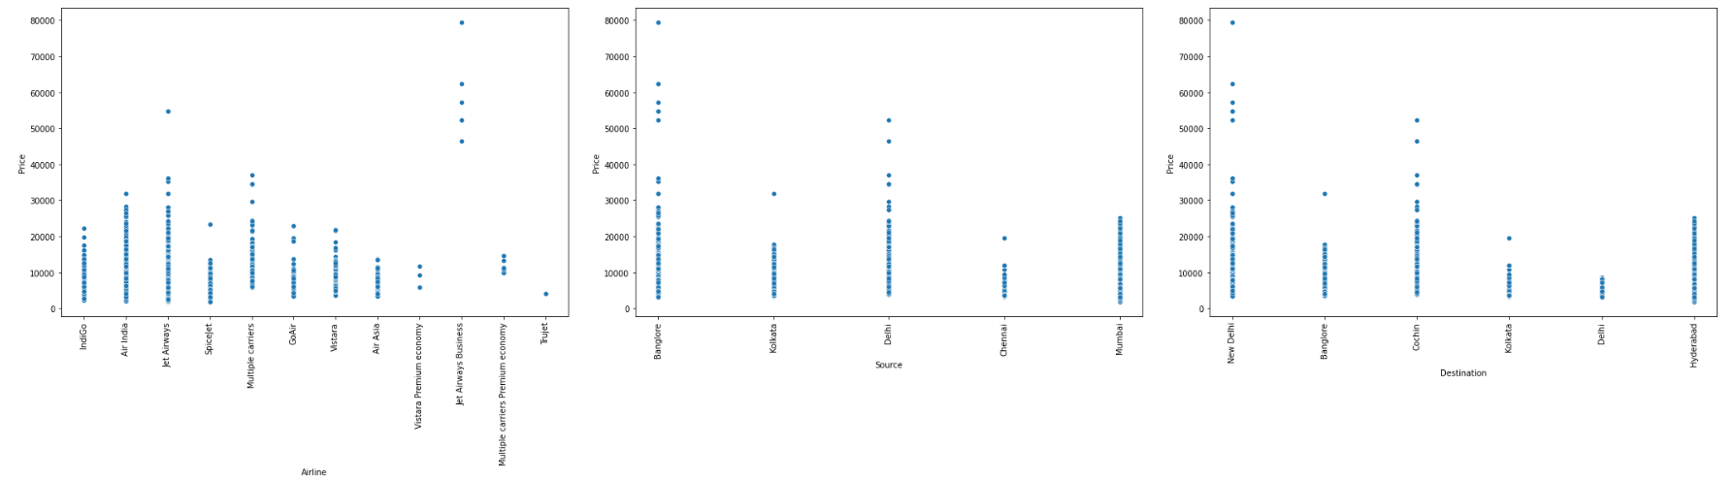
Comparing categorical variable with Target Column
Key Findings –
Jet airways business class has the highest prices between 50k — 80k
Prices for most airlines varies from 2k-20k.
All the high cost flights depart from bangalore, rest of the flights have prices between 3k — 50k
All high cost flights have destination as Delhi, rest of the flights have prices between 3k — 50k
Notes:
We make the following observations from above chart –
Jet airways business class has the highest prices between 50k — 80k
All the high cost flights depart from bangalore, rest of the flights have prices between 3k — 50k
All high cost flights have destination as Delhi, rest of the flights have prices between 3k — 50k
If a flight is of business class, its price would be high
The flights with high prices having 1 stop, have stop in Bombay
Flights with 2 stops, having higher prices, have stop in Delhi.

Slide 16
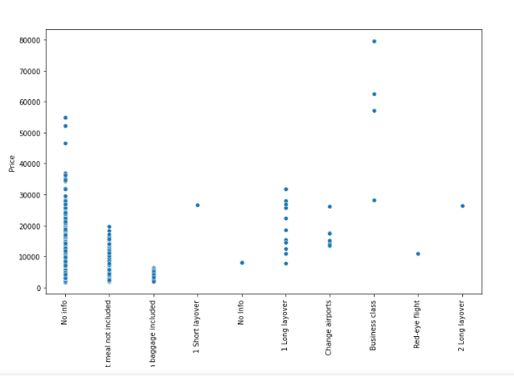
Comparing categorical variable with Target Column
Key Findings –
If a flight is of business class, its price would be high
More than 80 % of data in additional info is no info so I dropped this column.
Notes:
We make the following observations from above chart –
Jet airways business class has the highest prices between 50k — 80k
All the high cost flights depart from bangalore, rest of the flights have prices between 3k — 50k
All high cost flights have destination as Delhi, rest of the flights have prices between 3k — 50k
If a flight is of business class, its price would be high
The flights with high prices having 1 stop, have stop in Bombay
Flights with 2 stops, having higher prices, have stop in Delhi.

Slide 17
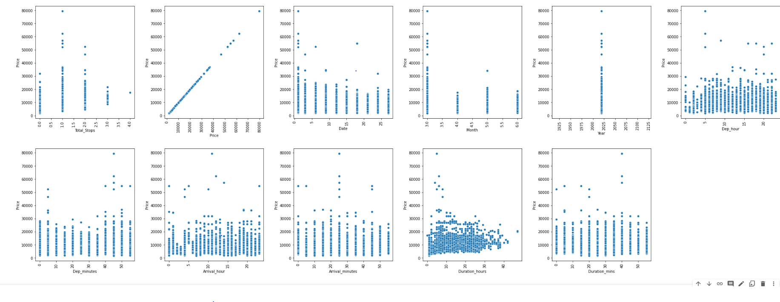
Comparing numerical col with ‘Price’
5
Key Findings-
As number of stops increase, the price range gets decreasing into a smaller price window (10k — 22k)
Flight prices are lesser during end of month and higher during the start of month
March is the most expensive month to fly
With increase in travel hours, price decreases
Price is high for morning flights , at around 5am, it decreases in afternoon, increases in evening

Slide 18
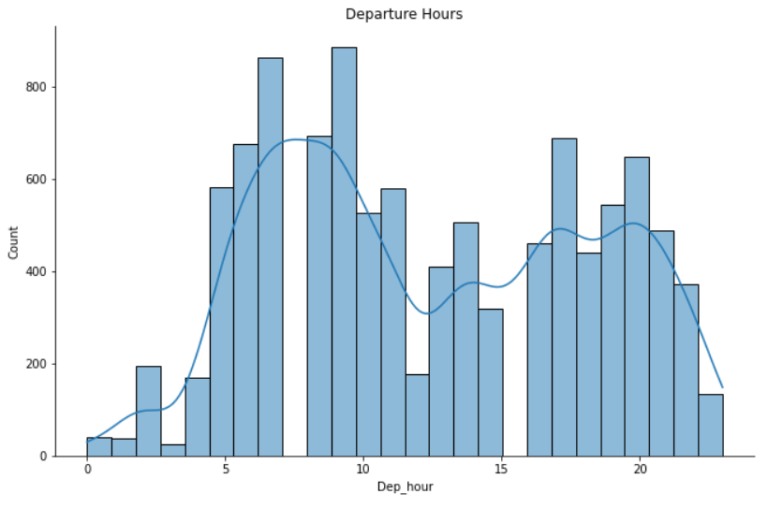
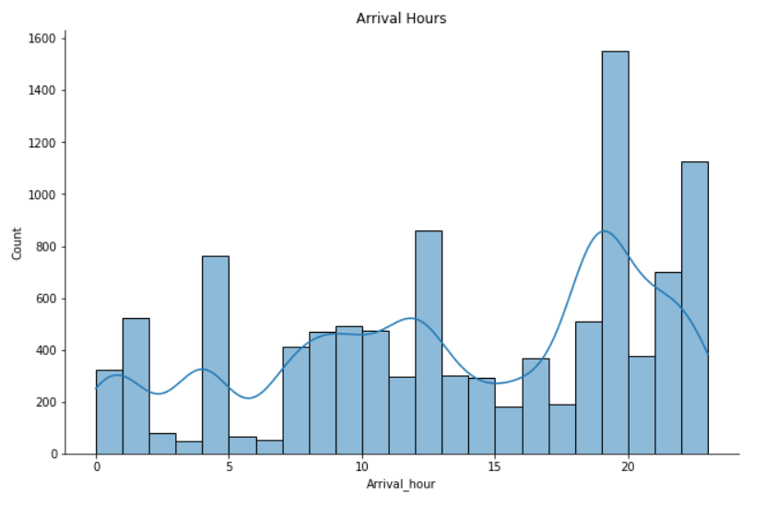
Peak Hour of Departure and Arrival
5
Key Findings-
Morning is the key time for departure.
Evening is the key time for arrival.

Slide 19
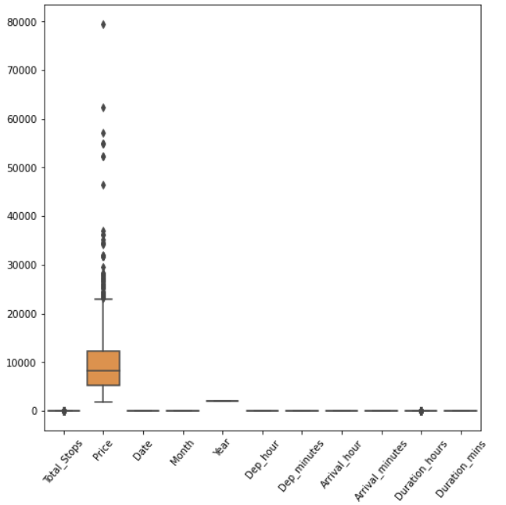

Steps of Data Preprocessing
7
Irrelevant Data Removal
Checking Outliers
Row, 6434, Flight time is ‘5m’, the plane cannot fly from mumbai to hyderabad with 2 stops in 5 min. So dropped this row.
6
8
Skewness Treatment
Treated skewness for ‘Duration Hours’ column, considering a threshold value for skewness as +/-0.5
Price is impacted by number of stops.
Duration hours shows a relation with price, hence those outliers weren’t treated.
High Priced Ticket such as that of a business class. These prices aren’t removed as this extreme value is a legitimate observation.

Slide 20
Steps for Data Preprocessing
Linear Regression Assumption Checking
9
1. Linearity
No linear relationship was found by using pair plot to check relation between dependent and independent Variable.
2. Checking Correlation
Heatmap was plotted to check correlation between variables
Correlation between duration_hour and total stops .
3. Test for Normality
Saphiro-Wilk normality test was performed and the data was observed to be non gaussian.
Handling Categorical Data:
One Hot Encoding
10
Nominal data was treated using one hot encoding
Notes:
Linear regression needs the relationship between the independent and dependent variables to be linear.

Slide 21
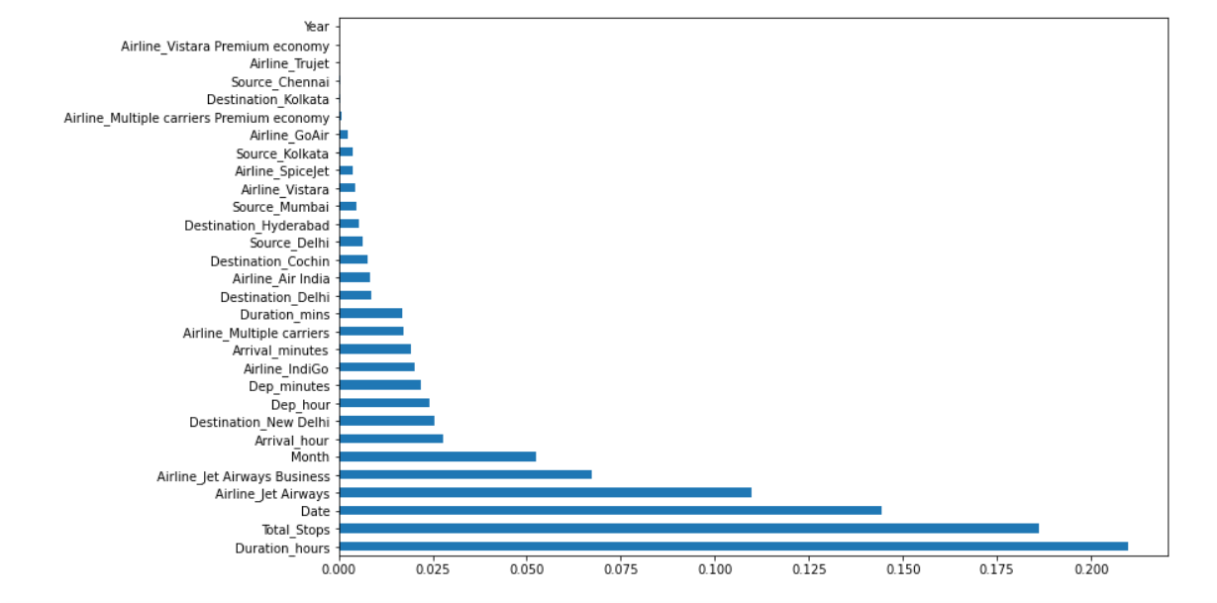
Feature Selection
The train data after applying EDA has 10462 rows and 31 columns.
Important features are found using ExtraTreesRegressor.
Plotted the graph of feature importances for better visualization
Important 14 features were selected for model building.
Notes:
Feature selection is nothing but to find the best feature that contributes the most and that has good relationship with the target values. The main reason to apply feature selection is to select important feature so that we don’t face the problem of multiple dimensions.

Slide 22
04
Model Building

Slide 23
Model Building
I have performed standard scaler .
Split train and test to build machine learning models.
Then we will run different models on this data.
Linear Regression
Decision Tree
Random Forest
XGBoost
By comparing with all the Algorithm Random Forest was giving the highest accuracy which is 95% for train data and 79% for test data.
Notes:
The Features where having different range so to make the data into same scale

Slide 24
Hyperparameter tuning
Hypertuning is done so as to improve random forest model performance.
I used RandomizedSearchCV for searching the hyperparameters space so as to find the best combination of hyperparameters for the Random Forest Model.
The Optimal Parameters were found and were used to train the final RF model for flight price prediction
This resulted in an improvement of model performance with better accuracy and lower error compared to initial model.

Slide 25
Future Work
I would like to build a web scraper based on real-time data from airline website. And then use flight Price Prediction model on it. This would help me to work on most up to date data. I could use this to find the best deals and plan trips in advance.
I would like to find and include data with additional features such as weather data, flight delay information, data of local events.

Slide 26

Thanks!
PERSONAL INFO:
Name: Tarun Reddy
Batch: PGDA 30

